Slide 1
CS 212 WEB PROGRAMMING I

Slide 2
Course Purpose
The “CS 212” is a beginner-level course, that teaches the basics of web development.
This course focuses on HTML, CSS, Bootstrap, JavaScript, and jQuery.
This course also covers the introduction to server-side scripting using NodeJS.
By the end of the course, you will have a solid foundation in web development that demonstrates their skills and understanding of the material.

Slide 3
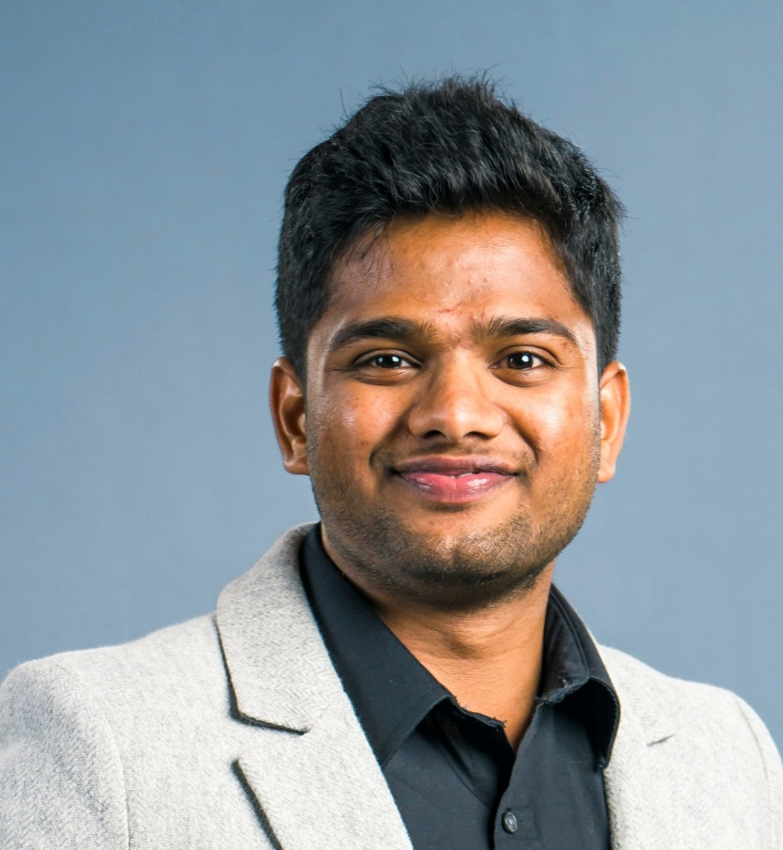
Instructor of Section 001
Name: Veera Surya Bhaskar Gali
Email: veera-surya-bhaskar.gali@nau.edu
Title: Lecturer
Education:
MS from Northern Arizona University, Flagstaff.
Experience:
3 years of Teaching & 3 years of Software Engineering.

Slide 4
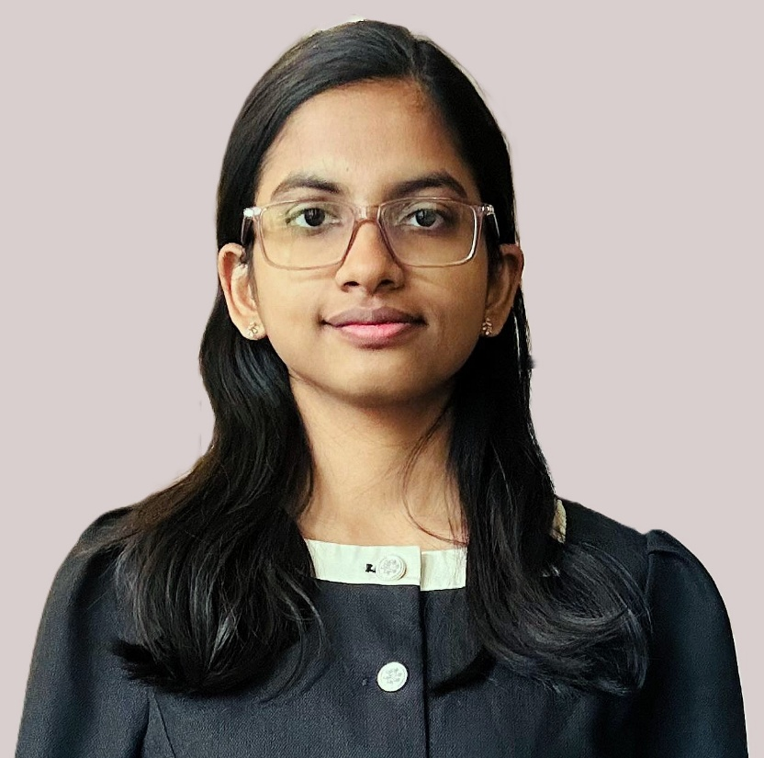
Instructor of Section 003
Name: Tayyaba Shaheen
Email: ts2434@nau.edu
Title: Lecturer
Education:
MS from Northern Arizona University, Flagstaff.
Experience:
3 years of Teaching

Slide 5
Grading Breakdown
The weight of each course component toward your final grade is
Grades will be assigned using the weighted sum described above using this scale:
A ≥ 90%, B ≥ 80%, C ≥ 70%, D ≥ 60%, F < 60%.
Assignment | Grade Weight (%)
Homework Assignments (x9) | 40%
Quizzes(x9) | 20%
Group Project Proposal (x1) | 5%
Group Project Report (x2) | 20%
Group Project Presentation (x1) | 15%

Slide 6
Assignment Deadlines
Quizzes & Homework Assignments:
We will available every Monday from 12 AM.
Due by the end of the Monday i.e., 11:59 PM MST following the week in which they are assigned.
Group Project Assignments:
Due by the end of second week from the available date.

Slide 7
Course Polices

Slide 8
Late Submission Policy
Penalty for Late Submissions:
Late Submissions will result in a 10% deduction per day beyond the original due date.
Extensions will be capped at a maximum of 3 days.
Medical Emergencies:
Medical emergencies will be considered only if a valid doctor’s certificate is provided. In such cases, a 20% penalty will be applied (a one-time penalty).
Other Exceptions:
Any other exceptions will be reviewed on a case-by-case basis and should be communicated well before the deadline.

Slide 9
Academic Integrity Violation Policy
Academic integrity in group project assignments, homework and/or quizzes, the following penalties will apply:
First occurrence: a grade of zero in the assignment
Second occurrence: a failing grade in the course.

Slide 10
Course Communication

Slide 11
Course Communication
Throughout the semester, we will use two primary modes of communication:
Email Communication (Formal):
Requesting personal meetings.
Requesting homework extensions.
Reporting absences.
Addressing technical issues with Canvas.
Discussing grading concerns.
Discord Communication (Informal):
Joining office hours.
Clarifying doubts regarding quizzes, homework and group projects.
Engaging in general course-related discussions such as finding project partner.

Slide 12
Email Communication
Contain the prefix “[CS 212]” in the subject, so that the message can be easily identified.
Contain a salutation, (for example, “Dear <Name of Your TA>/Dear Dr. <Last Name of Your Instructor>”)
The body of your message should also be respectful and explain the full context of the query.
Contain a closing, (for example, “Best regards,”)
Contain your full name
Although email will typically be answered quickly, you should allow up to three (3) business days for a response; but if it takes more than 3 days, feel free to send a reminder

Slide 13
Discord Communication
Discord Invite: https://discord.com/invite/ApsUp2uDtT
Link is place under “Getting Started” or “Syllabus” in Canvas.
To get access to all channels:
Navigate to "#welcome" and drop a message with your "FULL NAME According to your CANVAS".
Example:
VEERA SURYA BHASKAR GALI

Slide 14
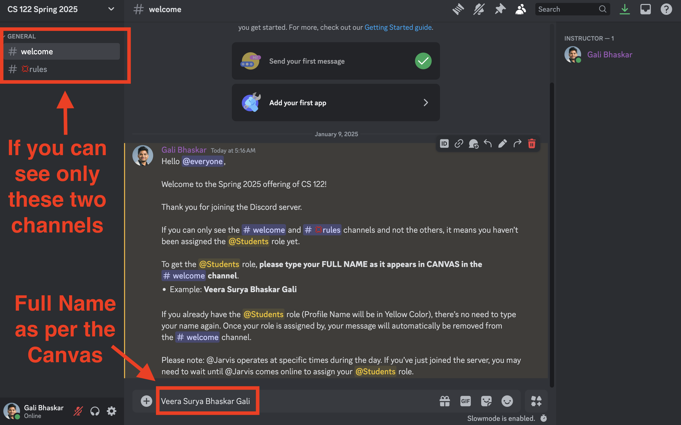

Discord Communication

Slide 15
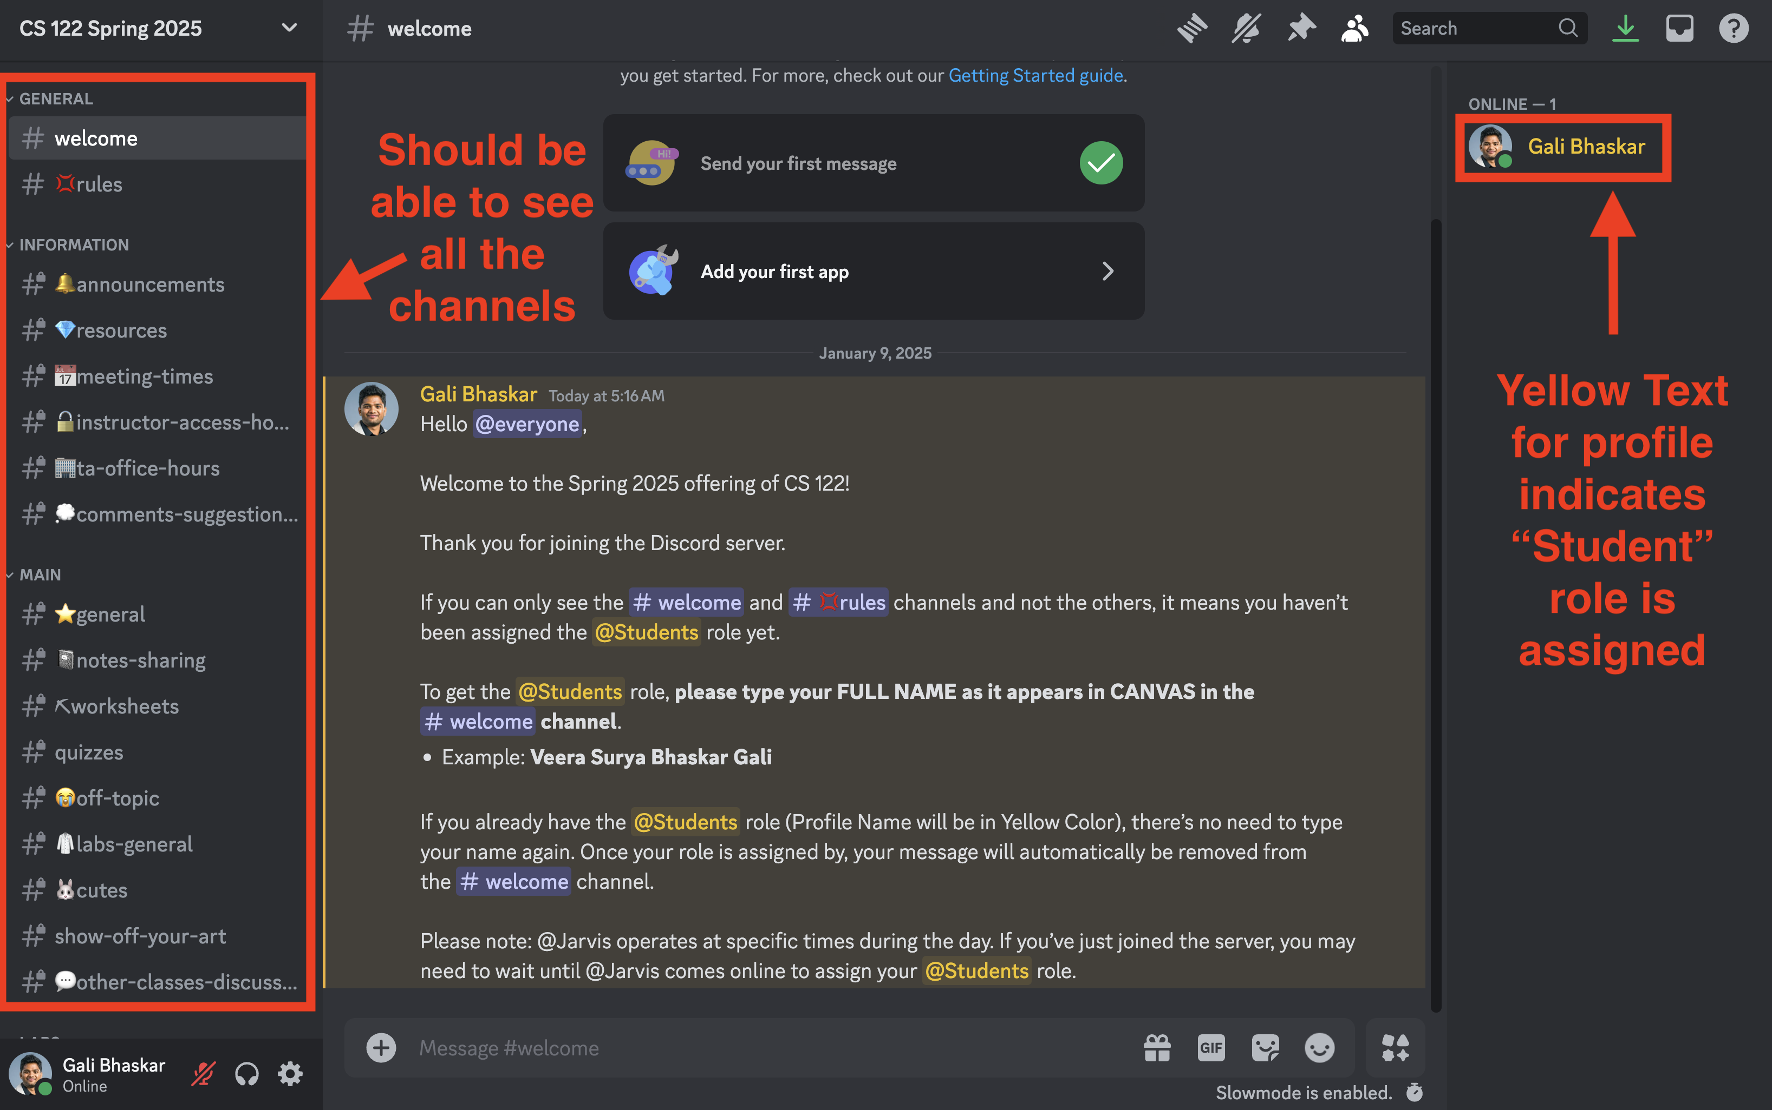
Discord Communication

Slide 16
Course Navigation Quiz

Slide 17
Course Navigation Quiz
The Course Navigation Quiz is mandatory to access the course content.
Key Details:
Unlimited attempts are allowed.
To complete the quiz, you must thoroughly review the course syllabus and achieve a score of 10/10.
There are two manually graded questions, which will be evaluated by the TAs periodically.
If you score 8/10, this likely means the two manually graded questions are pending review. Please be patient as TAs will update your grade in due time.
Ensure you complete the quiz promptly to unlock access to course materials.

Slide 18
Important Resources
This course is based on the Udemy course with additional resources.
Please enroll the below Udemy course.
The Complete 2024 Web Development Bootcamp
Instructions on how to enroll the course can be found in “Important Resources” Module.

Slide 19
Office Hours

Slide 20
Office Hours
Mode: Over Discord
Day: Scheduled will be updated in “#instructor hours” channel in Discord.
Timing: Will be announced in Discord.
Not able to Make it: Drop me an email and I will try my best to schedule an appointment in-person or over discord.

Slide 21
Canvas Notifications

Slide 22
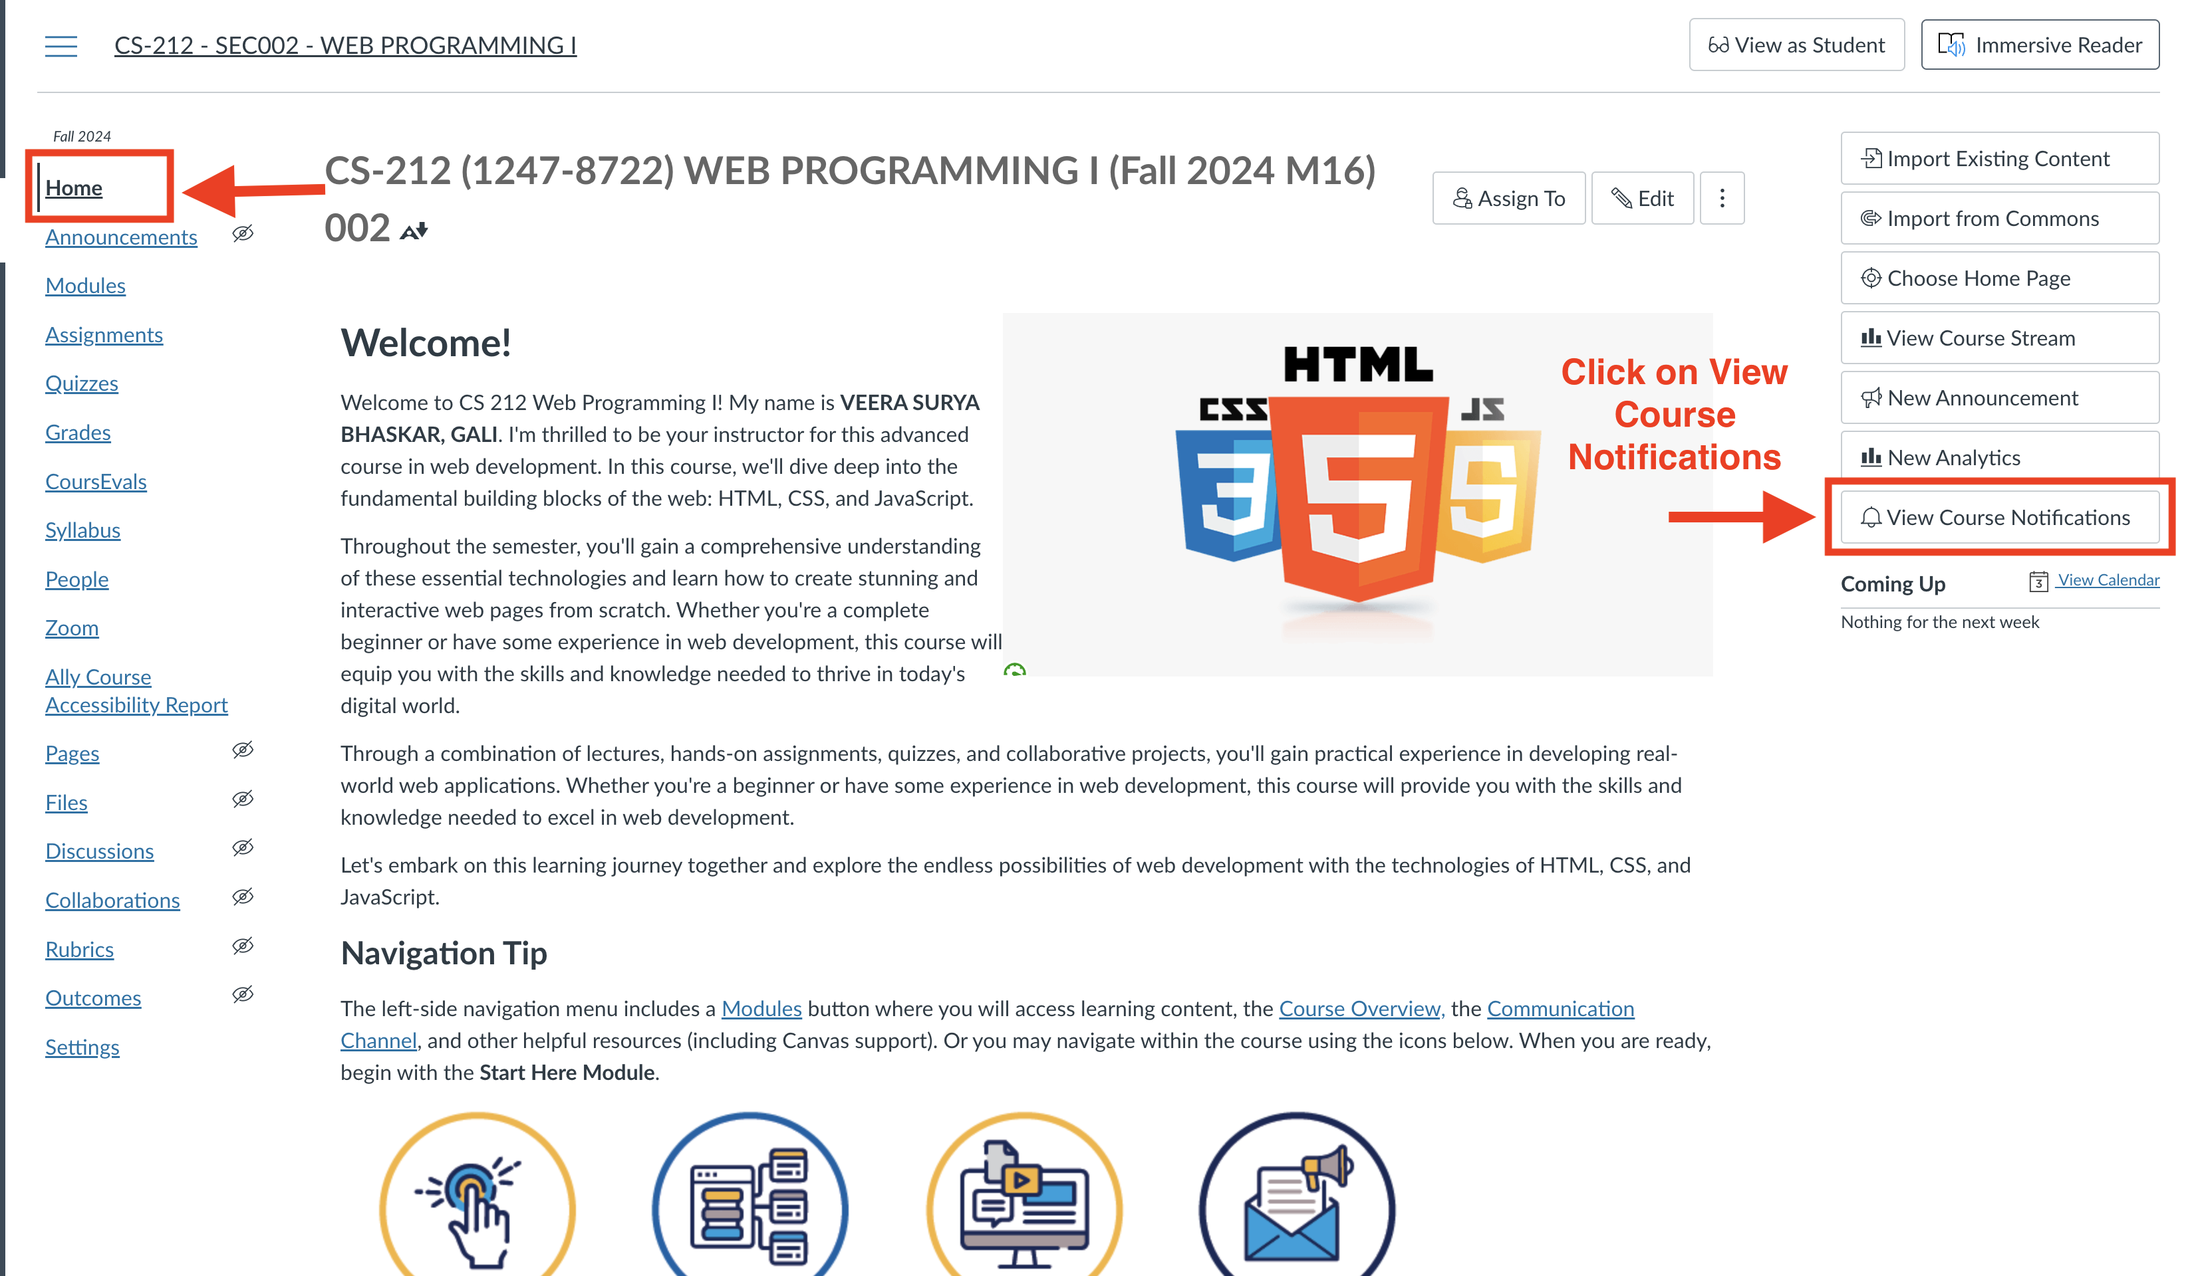
Announcement's
Please enable the following notifications to stay informed about any announcements or grade changes.

Slide 23
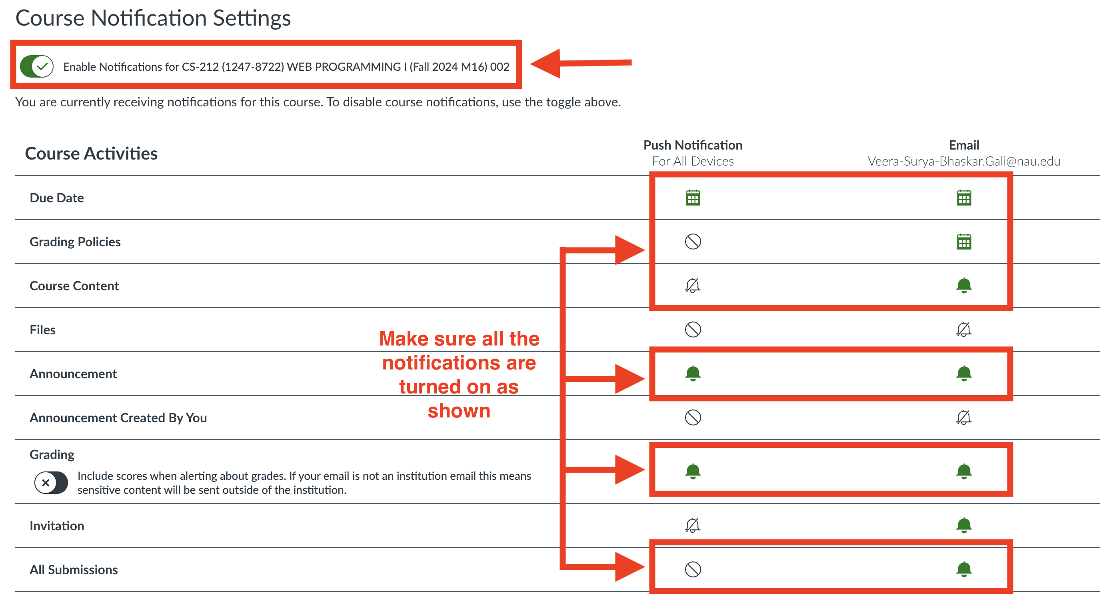
Announcement's Contd.
Make sure all the announcement settings are as follows:

Slide 24

Welcome to the Course

